Slide 1
zekeLabs
Kafka - Request Processing
Learning made Simpler ! www.zekeLabs.com

Slide 2
Agenda
Produce Request
Fetch Request

Slide 3
Produce Request
For each port the broker listens on, the broker runs an acceptor thread that creates a connection and hands it over to a processor thread for handling.
The number of processor threads (also called network threads) is configurable.
The network threads are responsible for taking requests from client connections, placing them in a request queue, and picking up responses from a response queue and sending them back to clients.

Slide 4
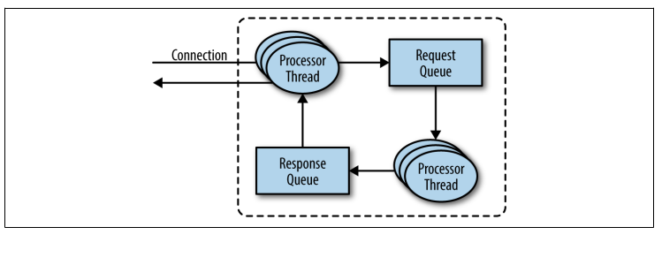

Slide 5
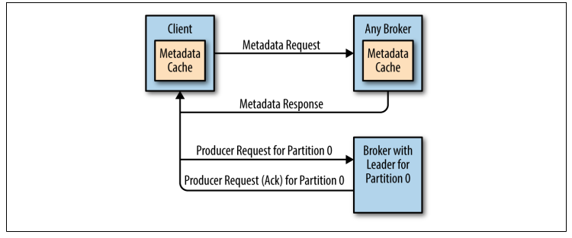
Info exchange

Slide 6
Both produce requests and fetch requests have to be sent to the leader replica of a partition.
If a broker receives a produce request for a specific partition and the leader for this partition is on a different broker, the client that sent the produce request will get an error response of “Not a Leader for Partition.”
The same error will occur if a fetch request for a specific partition arrives at a broker that does not have the leader for that partition.
Kafka’s clients are responsible for sending produce and fetch
requests to the broker that contains the leader for the relevant partition for the request.

Slide 7
Fetch Request
The client sends a request, asking the broker to send messages from a list of topics, partitions, and offsets—something like “Please send me messages starting at offset 53 in partition 0 of topic Test.
zero-copy

Slide 8
Thank You !!!

Slide 9
THANK YOU
Let us know how can we help your organization to Upskill the employees to stay updated in the ever-evolving IT Industry.
Get in touch:
www.zekeLabs.com | +91-8095465880 | info@zekeLabs.com
Visit : www.zekeLabs.com for more details

